Slide 1

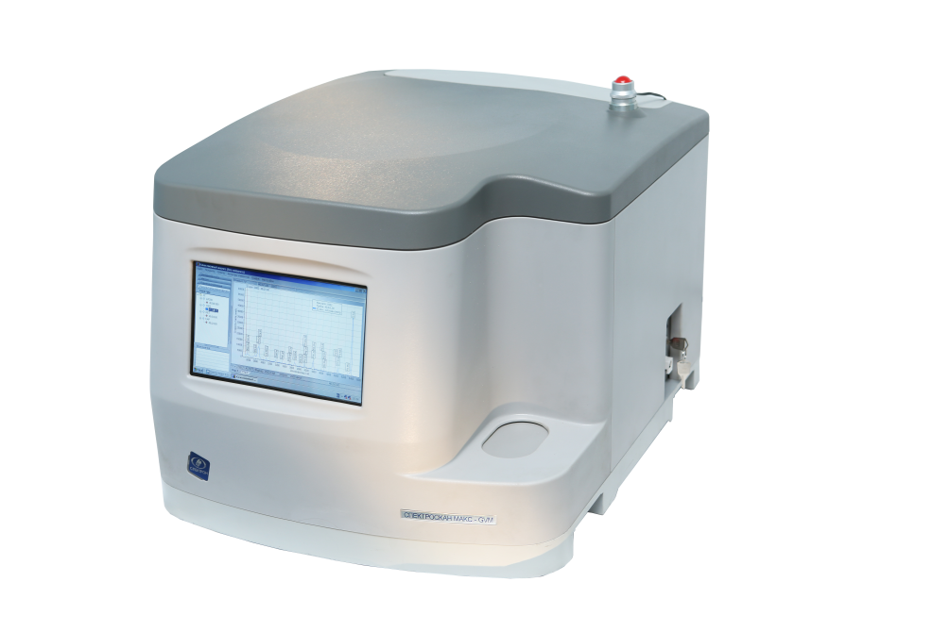
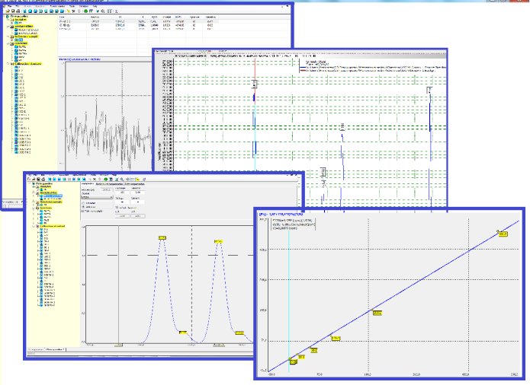
WDXRF SPECTROMETER
SPECTROSCAN MAKC-GVM
SPECTROSCAN MAKC-GVM is a benchtop instrument designed for elemental analysis of Na through U in solids, powders and liquids from ppm levels up to 100%.
The X-ray tube of the spectrometer is located above the sample holders which ensures a protection of an X-ray optics from any contamination due to a sample leakage. It makes possible to bring the X-ray tube and the entrance window of the detection system closer to a sample and thus achieve an excellent analytical performance without applying a helium purge. This X-ray geometry along with the focusing X-ray optics supports the usage of the low-power X-ray tube in the spectrometer and delivers low limit of detection due to high signal-to-noise ratio. The vacuum optical path provides high fluorescence intensities even for light elements like Na and Mg.
Features:
X-ray tube Voltage: 40 kV
X-ray Current: 4 mA
Anode: Pd
Analyzing crystals: LiF200, C002, RbAP, PET
Detector: sealed proportional counter
Optical path: Vacuum
Sample chamber: Air
Easy-to-use software for spectrum processing, calibration and sample analysis.
User may create and store as many calibration curves as needed.

Slide 2
SiO2, Al2O3, CaO, MgO and Fe2O3 determination
in cement with WDXRF spectrometer SPECTROSCAN MAKC-GVM
Wavelength-dispersive X-ray fluorescence (WDXRF) analysis is the method of choice for express determination of elements both in raw materials and in final products (i.e. cement and clinker) of the cement industry.
This report shows how SPECTROSCAN MAKC-GVM manages the task.
Calibration standards
11 samples of cement with known concentrations of SiO₂, Al₂O₃, CaO, MgO and Fe₂O₃ were provided for analysis. Six of them were used for the calibration, the rest – for the accuracy test.
Sample preparations
Samples were ground in a mill to get the particle size below 60 μm. Then the powders were pressed on a boric acid support into pellets at a pressure of 20 tons. Two pressed pellets were prepared from each cement sample. (The usage of fused beads for analysis is believed to enhance the accuracy of the measurement results, but it demands expensive additional equipment and complicates a sample preparation) .
Calibration
Calibration curves were established for each element by multiple regression method using «Spectr-Quant» Software.
Since the fusion method is employed it is possible to establish a single calibration for a material of different type.
Measurement results and calculations
When the calibration curve has been obtained, the samples were measured. The differences between duplicate measurements (│С_{#1}-С_{#2}│ ), the error between the nominal concentration of an element in the samples (C_{nom}.) and the average of the duplicate measurements ( C_{calc}.) were calculated.
The measurement results and the calculated data are shown in Tables 1 – 10.

Slide 3
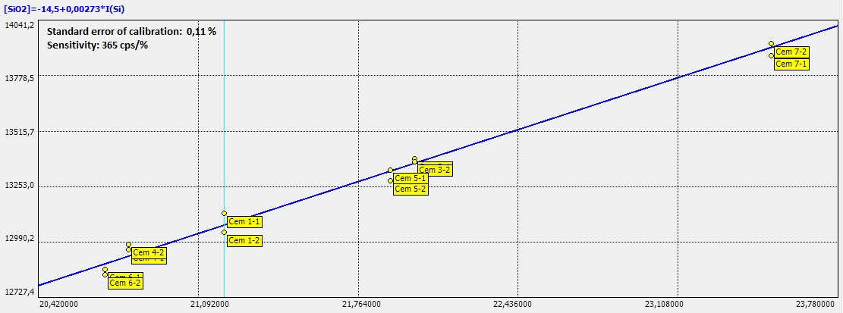
Si KA (1) measurement parameters
Analyzing crystal: LiF200
Current/Voltage: 4 mA/40 kV
Counting time: 10s
Sensitivity: 3645 cps/%
Calibration accuracy: 0.11% in the range from 20.3 % to 23.3 %
SiO2
Figure. 1 Calibration curve for SiO₂ in cement
Table 1 Calibration details
Standard | C_{nom}, % | C _{calc.#1}, _{#2}, % | │С_{#1}-С_{#2}│,% | │С_{nom}.-С _{av.}│, %
Cem 1-1 | 21,2 | 21,3 | 0,3 | 0,1
Cem 1-2 |  | 21,1 |  | 0,1
Cem 3-1 | 22,0 | 22,0 | 0,0 | 0,0
Cem 3-2 |  | 22,0 |  | 0,0
Cem 4-1 | 20,8 | 20,9 | 0,1 | 0,1
Cem 4-2 |  | 21,0 |  | 0,2
Cem 5-1 | 21,9 | 21,9 | 0,1 | 0,0
Cem 5-2 |  | 21,8 |  | 0,1
Cem 6-1 | 20,7 | 20,6 | 0,1 | 0,1
Cem6-2 |  | 20,6 |  | 0,1
Cem 7-1 | 23,5 | 23,4 | 0,2 | 0,1
Cem 7-2 |  | 23,6 |  | 0,1
Table 2 Repeatability and accuracy test
Sample | C_{nom.}, % | C_{calc#1, #2}, % | │С_{#1}-С_{#2}│,% | C_{av}., % | │С_{nom}.-С _{av.}│, %
Cem #2 | 20,3 | 19,9 | 0,2 | 20,0 | 0,3
 |  | 20,1
Cem #8 | 23,3 | 22,6 | 0,4 | 22,8 | 0,5
 |  | 23,0
Cem #9 | 21,9 | 21,6 | 0,1 | 21,7 | 0,2
 |  | 21,7
Cem #10 | 20,9 | 21,1 | 0,1 | 21,1 | 0,2
 |  | 21,0
Cem #11 | 21,5 | 21,9 | 0,2 | 22,0 | 0,5
 |  | 22,1
The maximum difference between the average of duplicate measurements and the nominal concentration was 0.5 % by mass for the SiO₂ determination in cement. The maximum difference between the duplicate measurements was 0.4 %.

Slide 4
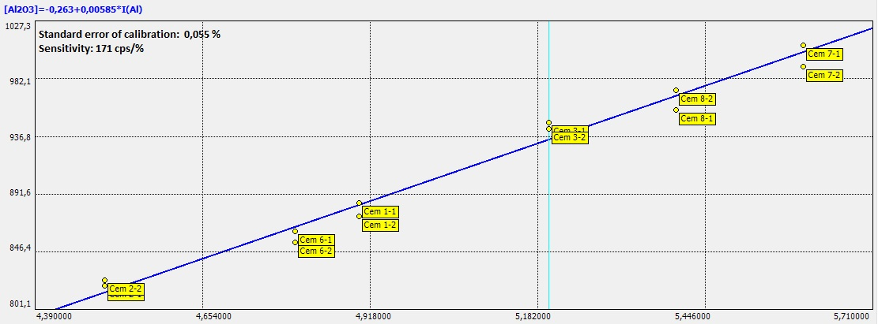
Al KA (1) measurement parameters
Analyzing crystal: RbAP
Current/Voltage: 4 mA/40 kV
Counting time: 20s
Sensitivity: 171 cps/%
Calibration accuracy: 0.055 % in the range from 4,8 % to 5,6 %
Al2O3
Figure. 2 Calibration curve for Al₂O₃ in cement
Table 3 Calibration details
Standard | C_{nom}, % | C _{calc.#1}, _{#2}, % | │С_{#1}-С_{#2}│,% | │С_{nom}.-С _{av.}│, %
Cem 1-1 | 4,9 | 4,91 | 0,06 | 0,01
Cem 1-2 |  | 4,85 |  | 0,05
Cem 2-1 | 4,5 | 4,53 | 0,02 | 0,03
Cem 2-2 |  | 4,55 |  | 0,05
Cem 3-1 | 5,2 | 5,27 | 0,03 | 0,07
Cem 3-2 |  | 5,24 |  | 0,04
Cem 6-1 | 4,8 | 4,78 | 0,04 | 0,02
Cem 6-2 |  | 4,74 |  | 0,06
Cem 7-1 | 5,6 | 5,62 | 0,06 | 0,02
Cem 7-2 |  | 5,56 |  | 0,04
Cem 8-1 | 5,4 | 5,37 | 0,05 | 0,03
Cem 8-2 |  | 5,42 |  | 0,02
Table 4 Repeatability and accuracy test
Sample | C_{nom}., % | C_{calc#1, #2}, % | │С#1-С#2│, % | C _{av.}, % | │С_{nom.-С av.}│, %
Cem #4 | 4,9 | 4,97 | 0,04 | 5,0 | 0,05
 |  | 4,93
Cem #5 | 4,9 | 4,95 | 0,07 | 4,9 | 0,02
 |  | 4,89
Cem #8 | 5,4 | 5,34 | 0,08 | 5,4 | 0,02
 |  | 5,42
Cem #9 | 5,2 | 5,22 | 0,06 | 5,3 | 0,05
 |  | 5,28
Cem #10 | 4,8 | 4,82 | 0,07 | 4,8 | 0,01
 |  | 4,75
The maximum difference between the average of duplicate measurements and the nominal concentration was 0.08 mass % for the Al₂O₃ determination in cement. The maximum difference between the duplicate measurements was 0.07 mass %.

Slide 5
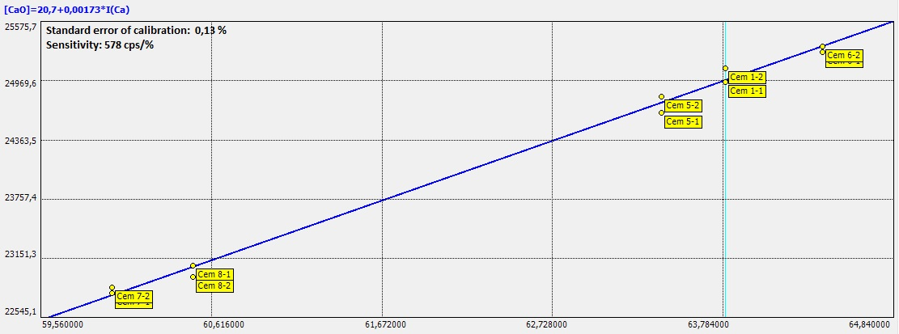
Ca KB (1) measurement parameters Ca KB (1)
Analyzing crystal: C002
Current/Voltage: 0.5 mA/40 kV
Counting time: 50 s
Sensitivity: 579 cps/%
Calibration accuracy: 0.13 % in the range from 59.2 % to 64.4 %
CaO
Figure. 3 Calibration curve for CaO in cement
Table 5 Calibration details
Standard | C_{nom}, % | C _{calc.#1}, _{#2}, % | │С_{#1}-С_{#2}│,% | │С_{nom}.-С _{av.}│, %
Cem 1-1 | 63,8 | 63,77 | 0,23 | 0,03
Cem 1-2 |  | 64,00 |  | 0,20
Cem 5-1 | 63,4 | 63,23 | 0,28 | 0,17
Cem 5-2 |  | 63,50 |  | 0,10
Cem 6-1 | 64,4 | 64,29 | 0,11 | 0,11
Cem 6-2 |  | 64,40 |  | 0,00
Cem 7-1 | 60,0 | 60,04 | 0,09 | 0,04
Cem 7-2 |  | 60,13 |  | 0,13
Cem 8-1 | 60,5 | 60,52 | 0,21 | 0,02
Cem 8-2 |  | 60,32 |  | 0,18
Table 6 Repeatability and accuracy test
Sample | C_{nom.}, % | C_{calc#1, #2}, % | │С_{#1}-С_{#2}│,% | C_{av}., % | │С_{nom}.-С _{av.}│, %
Cem #2 | 64,4 | 63,87 | 0,14 | 63,9 | 0,42
 |  | 64,01
Cem #3 | 63,8 | 63,45 | 0,01 | 63,4 | 0,36
 |  | 63,43
Cem #4 | 62,3 | 62,71 | 0,20 | 62,81 | 0,51
 |  | 62,91
Cem #9 | 59,2 | 60,04 | 0,20 | 59,94 | 0,74
 |  | 59,84
Cem #10 | 60,1 | 59,91 | 0,13 | 59,8 | 0,26
 |  | 59,78
The maximum difference between the average of the duplicate measurements and the nominal concentration was 0.74 % by mass for the CaO determination in cement. The maximum difference between the duplicate measurements was 0.3 %.

Slide 6
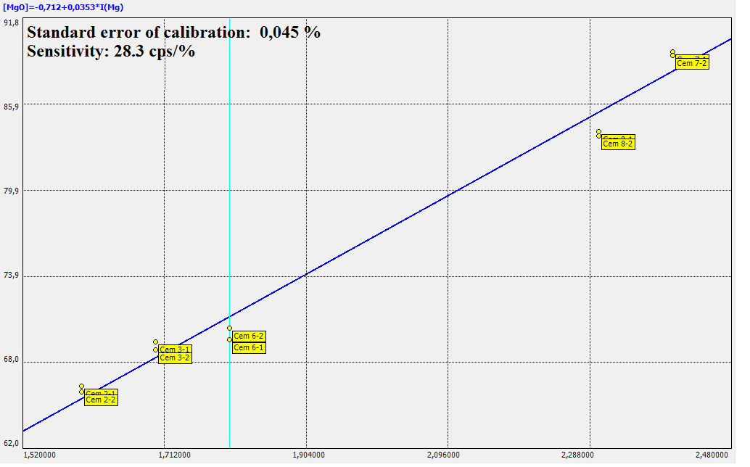
Mg KA (1) measurement parameters Ca KB (1)
Analyzing crystal: RhAP
Current/Voltage: 4.0 mA/40 kV
Counting time: 100 s
Sensitivity: 28.7 cps/%
Calibration accuracy: 0.045 % in the range from 1.5 % to 2.6 %
MgO
Figure. 4 Calibration curve for MgO in cement
Table 7 Calibration details
Standard | C_{nom}, % | C _{calc.#1}, _{#2}, % | │С_{#1}-С_{#2}│,% | │С_{nom}.-С _{av.}│, %
Cem 2-1 | 1,5 | 1,53 | 0,01 | 0,03
Cem 2-2 |  | 1,52 |  | 0,02
Cem 3-1 | 1,7 | 1,74 | 0,02 | 0,04
Cem 3-2 |  | 1,72 |  | 0,02
Cem 6-1 | 1,8 | 1,74 | 0,03 | 0,06
Cem 6-2 |  | 1,77 |  | 0,03
Cem 7-1 | 2,6 | 2,65 | 0,01 | 0,05
Cem 7-2 |  | 2,64 |  | 0,04
Cem 8-1 | 2,3 | 2,25 | 0,01 | 0,05
Cem 8-2 |  | 2,24 |  | 0,06
Table 8 Repeatability and accuracy test
Sample | C_{nom.}, % | C_{calc#1, #2}, % | │С_{#1}-С_{#2}│,% | C_{av}., % | │С_{nom}.-С _{av.}│, %
Cem #1 | 1,8 | 1,72 | 0,07 | 1,8 | 0,05
 |  | 1,78
Cem #4 | 1,7 | 1,83 | 0,10 | 1,8 | 0,08
 |  | 1,73
Cem #5 | 1,7 | 1,85 | 0,07 | 1,8 | 0,11
 |  | 1,78
Cem #9 | 2,1 | 2,27 | 0,03 | 2,3 | 0,19
 |  | 2,30
Cem #10 | 2,3 | 2,34 | 0,02 | 2,4 | 0,05
 |  | 2,36
The maximum difference between the average of the duplicate measurements and the nominal concentration was 0.2 % by mass for the MgO determination in cement. The maximum difference between the duplicate measurements was 0.1 %.

Slide 7
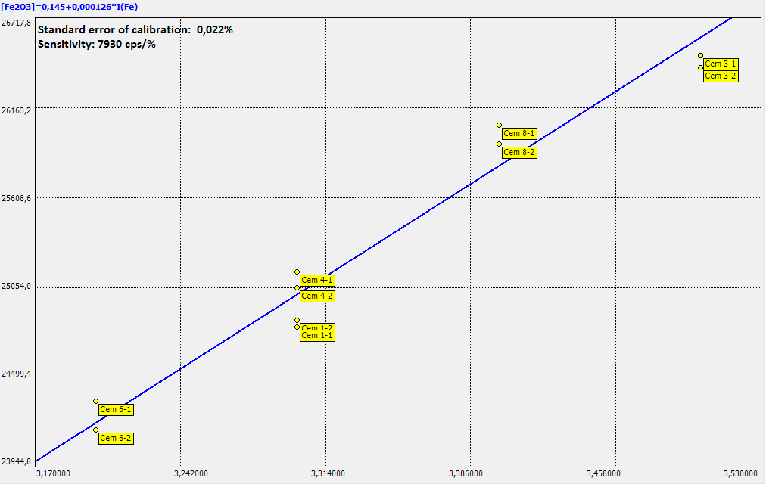
Fe KA (1) measurement parameters Ca KB (1)
Analyzing crystal: LiF200
Current/Voltage: 1.0 mA/40 kV
Counting time: 10 s
Sensitivity: 7930 cps/%
Calibration accuracy: 0.022 % in the range from 2,9 % to 3.6 %
Fe2O3
Figure. 5 Calibration curve for Fe2O3 in cement
Table 9 Calibration details
Standard | C_{nom}, % | C _{calc.#1}, _{#2}, % | С#1-С#2, % | С_{nom}-С_{res}, %
Cem 1-1 | 3,3 | 3,27 | 0,01 | 0,03
Cem 1-2 |  | 3,28 |  | 0,02
Cem 3-1 | 3,6 | 3,58 | 0,02 | 0,02
Cem 3-2 |  | 3,56 |  | 0,04
Cem 4-1 | 3,3 | 3,35 | 0,02 | 0,05
Cem 4-2 |  | 3,33 |  | 0,03
Cem 6-1 | 2,9 | 2,91 | 0,02 | 0,01
Cem 6-2 |  | 2,89 |  | 0,01
Cem 8-1 | 3,4 | 3,43 | 0,03 | 0,03
Cem 8-2 |  | 3,40 |  | 0,00
Table 10 Repeatability and accuracy test
Sample | C nom., % | Ccalc#1, #2, % | │С#1-С#2│,% | Cav., % | │Сnom.-С av.│, %
Cem #2 | 3,7 | 3,50 | 0,05 | 3,5 | 0,18
 |  | 3,55
Cem #5 | 3,2 | 3,29 | 0,03 | 3,3 | 0,11
 |  | 3,32
Cem #7 | 3,4 | 3,48 | 0,01 | 3,5 | 0,07
 |  | 3,47
Cem #9 | 3,3 | 3,46 | 0,05 | 3,5 | 0,18
 |  | 3,51
Cem #10 | 3,6 | 3,52 | 0,09 | 3,6 | 0,04
 |  | 3,61
The maximum difference between the average of the duplicate measurements and the nominal concentration was 0.2 % by mass for the Fe₂O₃ in cement. The maximum difference between the duplicate measurements was 0.1 %.

Slide 8
Conclusion
The results of the accuracy test obtained with the WDXRF spectrometer SPECTROSCAN MAKC-GVM allow to evaluate the Standard Error of Estimate (SEE) for the SiO2, Al2O3, CaO, MgO and Fe2O3 determination in cement. The values of the SEE and the measurement repeatability are listed in Table 11
Table 11
Analyte | SEE, mass % | Repeatability, mass %
CaO | 0,75 | 0,30
SiO₂ | 0,50 | 0,40
Fe₂O₃ | 0,20 | 0,09
MgO | 0,20 | 0,10
Al₂O₃ | 0,10 | 0,07
The WDXRF analysis, which includes a sample preparation by pressing powders on a boric acid support into pellets, is an extremely express and easy way to get accurate and reliable values of the SiO₂, Al₂O₃, CaO, MgO and Fe₂O₃ concentrations in materials of the cement industry .
The fusion method of a sample preparation should be preferred when higher accuracy and an exclusion of the inter-elements and matrix effects are required.

